Slide 1

Loan Approval Prediction using Machine Learning
Course: Data System Architecture BDAT 1002
Professor - Robin Huang
Project done by- Group 8
Rimi Mondal 200543066 – Project Manager
John Varghese Poomugath Baby 200498047- Data Analyst
Mownika Radhakrishnan 200511584 - Developer
Prachiben Bhaveshkumar Patel 200520109– Business Analyst
Jeel Shaileshkumar Patel 200556759 – Technical Lead

Slide 2

INTRODUCTION

Slide 3



BACKGROUND
We developed a machine learning model to predict creditworthiness based on demographic and financial factors.
The dataset contains information on 614 loan applicants and was obtained from Kaggle.
Our project includes data cleaning, exploratory data analysis, and modeling techniques to create the final machine learning model.
The project's audiences include finance and banking professionals, data scientists and researchers, students and educators in data science and finance, and individuals interested in personal finance and loan eligibility.

Slide 4
DATA DESCRIPTION
The dataset was obtained from Kaggle and contains 13 variables, 12 independent and 1 dependent.
The dataset used in this project is called "Loan Prediction" and was uploaded to Kaggle by user Vikas U Kani.
The dataset includes information on 614 loan applicants, each represented by a row in the dataset.
INDEPENDENT VARIABLES
Gender,
Married,
Dependents,
Education,
Self_Employed,
ApplicantIncome,
CoapplicantIncome,
LoanAmount,
Loan_Amount_Term,
Credit_History,
Property_Area, and
Total_Income
The data cleaning and preprocessing steps involved identifying and handling missing values in the dataset.
The following variables had missing values:
Gender,
Married,
Dependents,
Self-Employed,
LoanAmount,
Loan_Amount_Term, and
Credit_History.
Missing categorical values were imputed using the mode, and missing numerical values were imputed using the median.
DEPENDENT VARIABLE
Loan_Status
It indicates whether a loan application was approved (labeled as 'Y') or not approved (labeled as 'N')

Slide 5

WORKFLOW

Slide 6

PROCESS
DATA COLLECTION
Gather the dataset from a reliable source, such as Kaggle.
DATA PREPROCESSING
Preprocess the data by removing duplicates and missing values, converting categorical data into numerical data, and standardizing numerical data.
DATA ANALYSIS
Conduct exploratory data analysis to identify relationships between the variables and the loan status. Visualize the data using plots and charts to gain insights into the data.
FEATURE ENGINEERING
Create new features from existing data that may be more predictive of the loan status.
MODEL SELECTION
Select an appropriate model for the task of predicting loan eligibility. Consider using classification models like logistic regression, decision trees, or random forests.
MODEL TRAINING
Train the selected model on the preprocessed data using appropriate training techniques.
MODEL EVALUATION
Evaluate the performance of the model using evaluation metrics such as accuracy, precision, recall, and F1 score.
HYPERPARAMETER TUNING
Tune the hyperparameters of the model using techniques like GridSearchCV to improve its performance.
MODEL DEPLOYMENT
Deploy the trained and optimized model in a production environment where it can make accurate loan eligibility predictions.
MONITORING AND MAINTENANCE
Monitor the model's performance in the production environment, retrain it periodically, and update it as necessary to maintain its accuracy and relevance.

Slide 7

DATA CLEANING AND PREPROCESSING

Slide 8

DETAILED STEPS
The first step was importing necessary libraries for data analysis and machine learning, such as pandas, numpy, scikit-learn, and matplotlib.
Null values, duplicates, and NAN values were dropped from the dataset to ensure clean and accurate data.
The data was transposed to make it easier to work with and analyze.
NAN values were checked and replaced if necessary, using methods like mean or median.
Inconsistent values were identified by looking at unique values in each column and ensuring they were within the expected range.
Outliers were removed from the test data using methods like z-score and the IQR method to ensure the accuracy of the model.
Outliers were also removed from the train data using the same methods as for the test data.
Once the data was cleaned, it was exported to a CSV file for further analysis.
A random forest algorithm was used to build a machine learning model that could predict outcomes based on the data.
The confusion matrix and error rate were calculated to evaluate the accuracy of the model and identify areas for improvement.

Slide 9
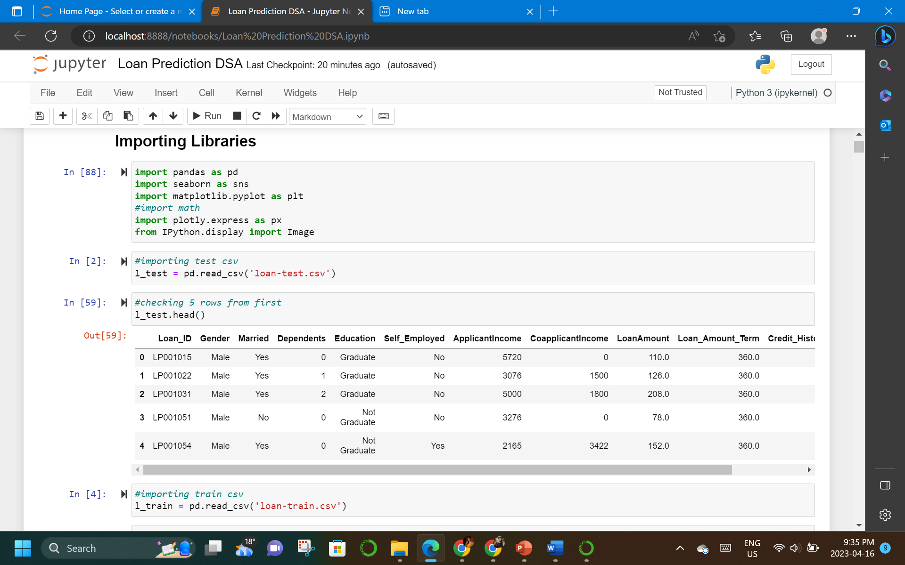
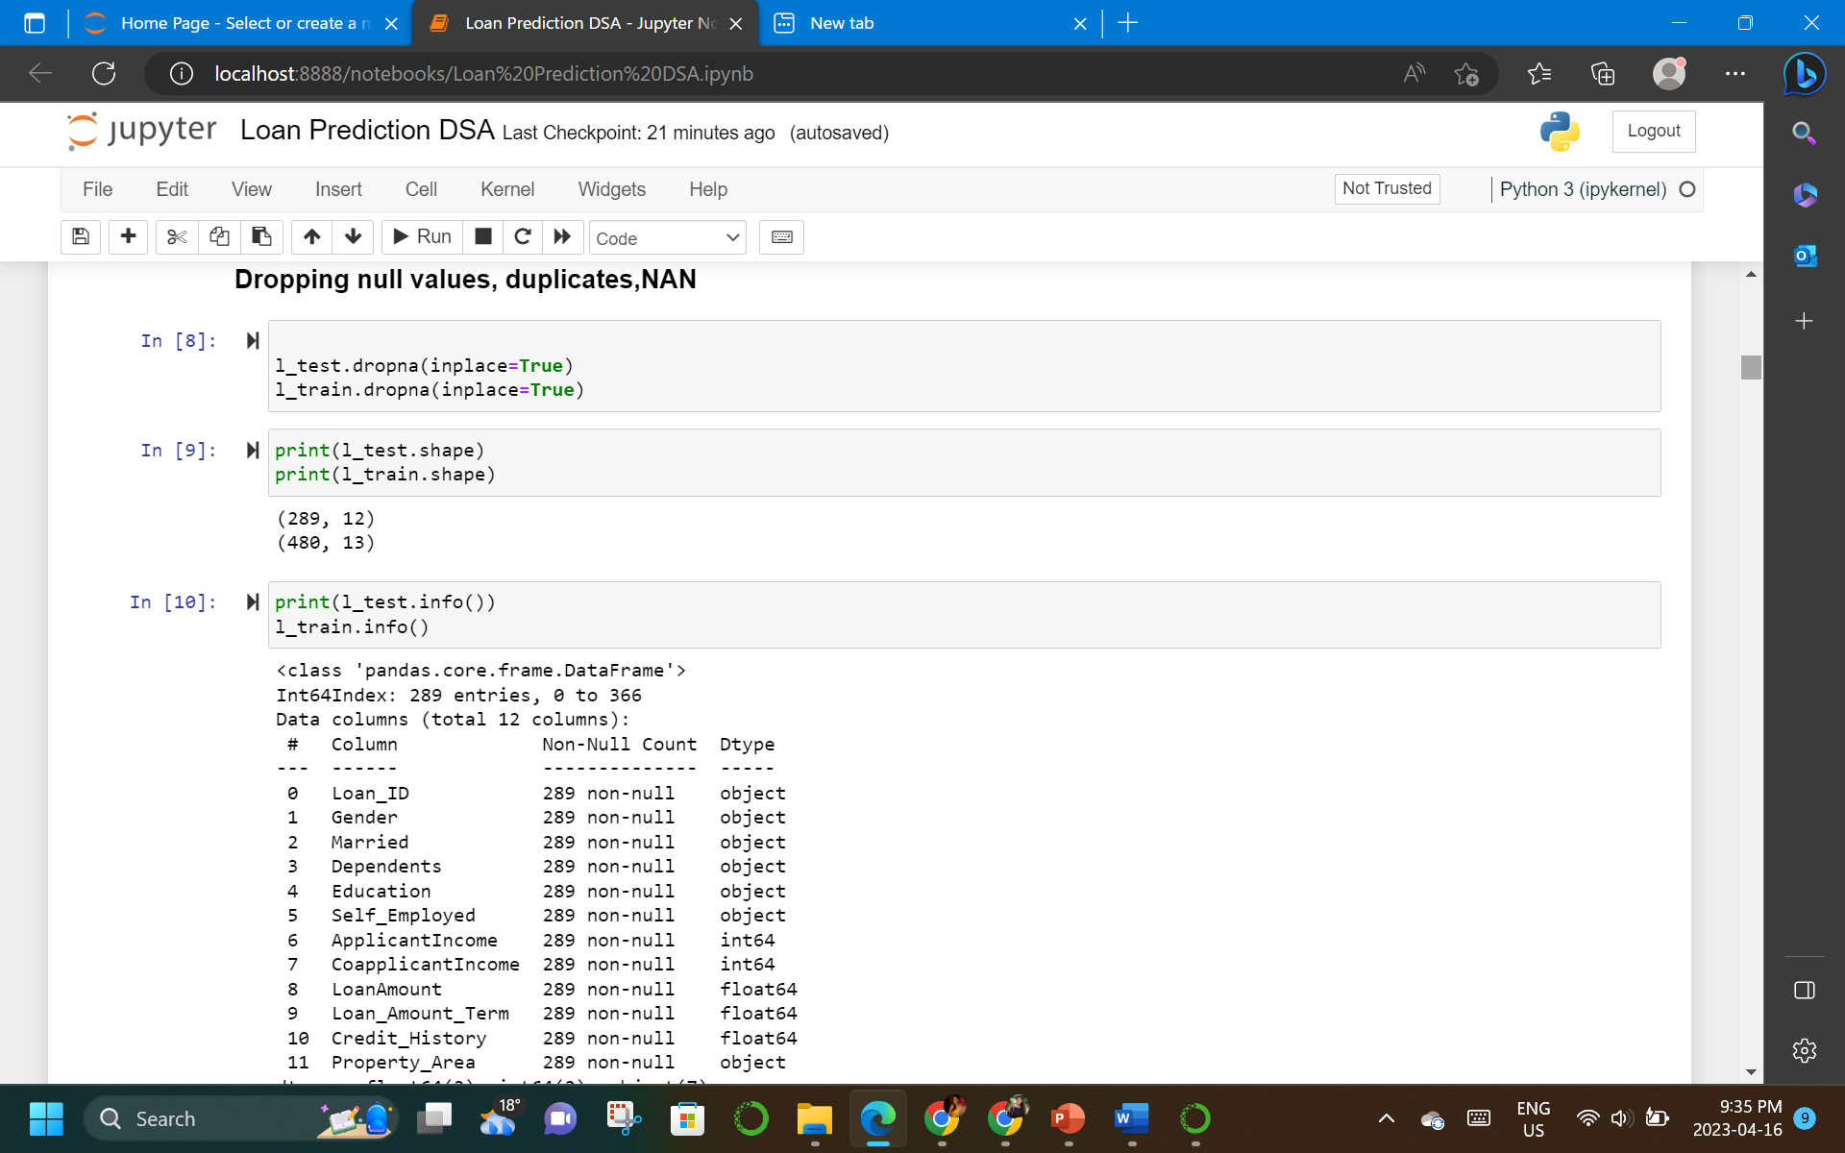
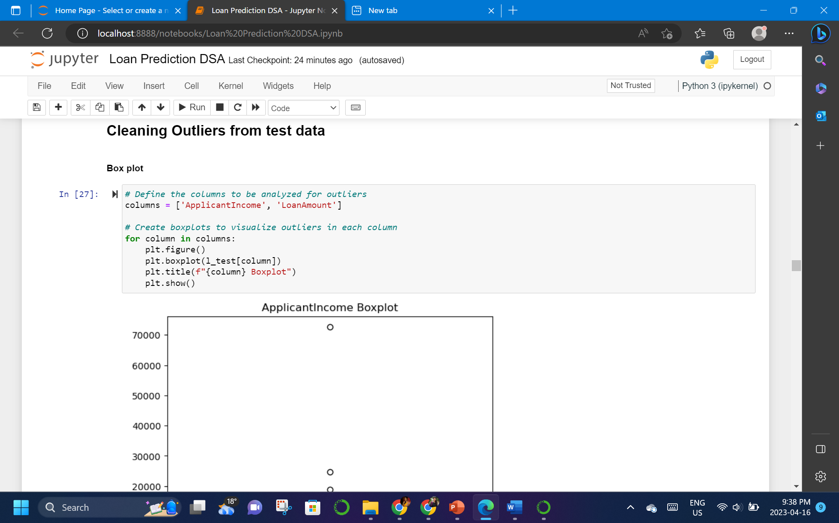
STEP 1 TO 6

Slide 10
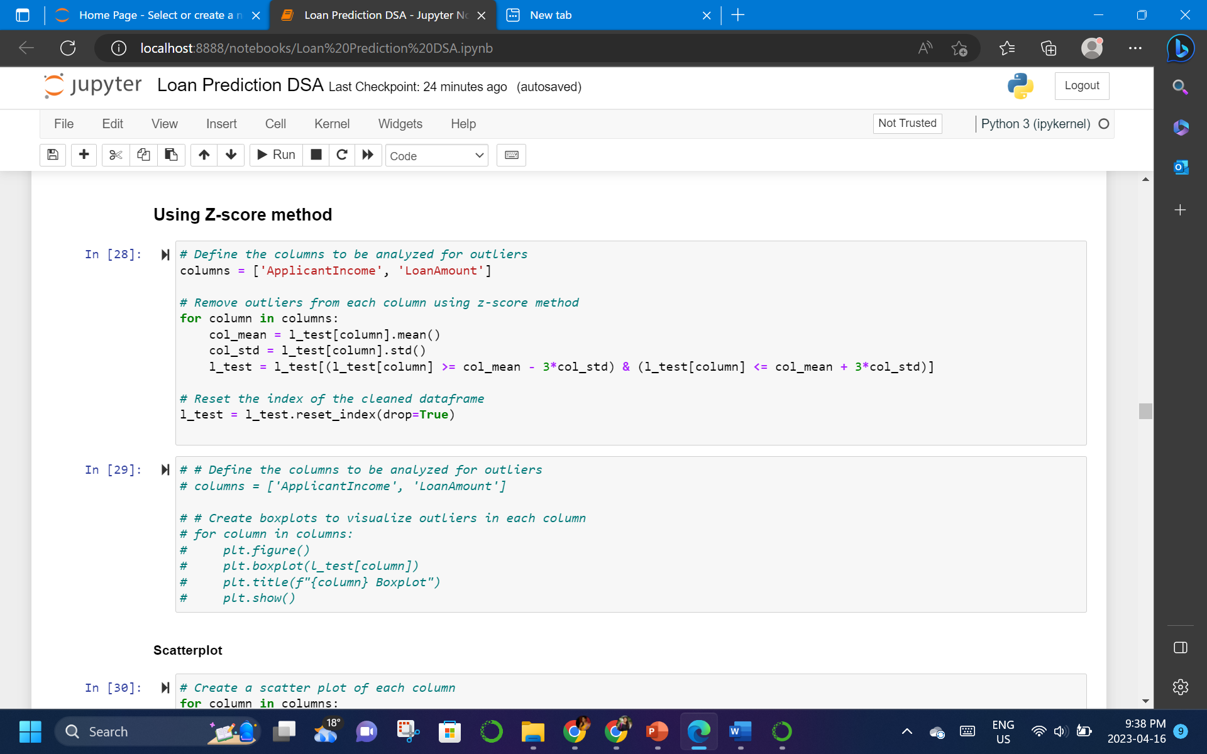
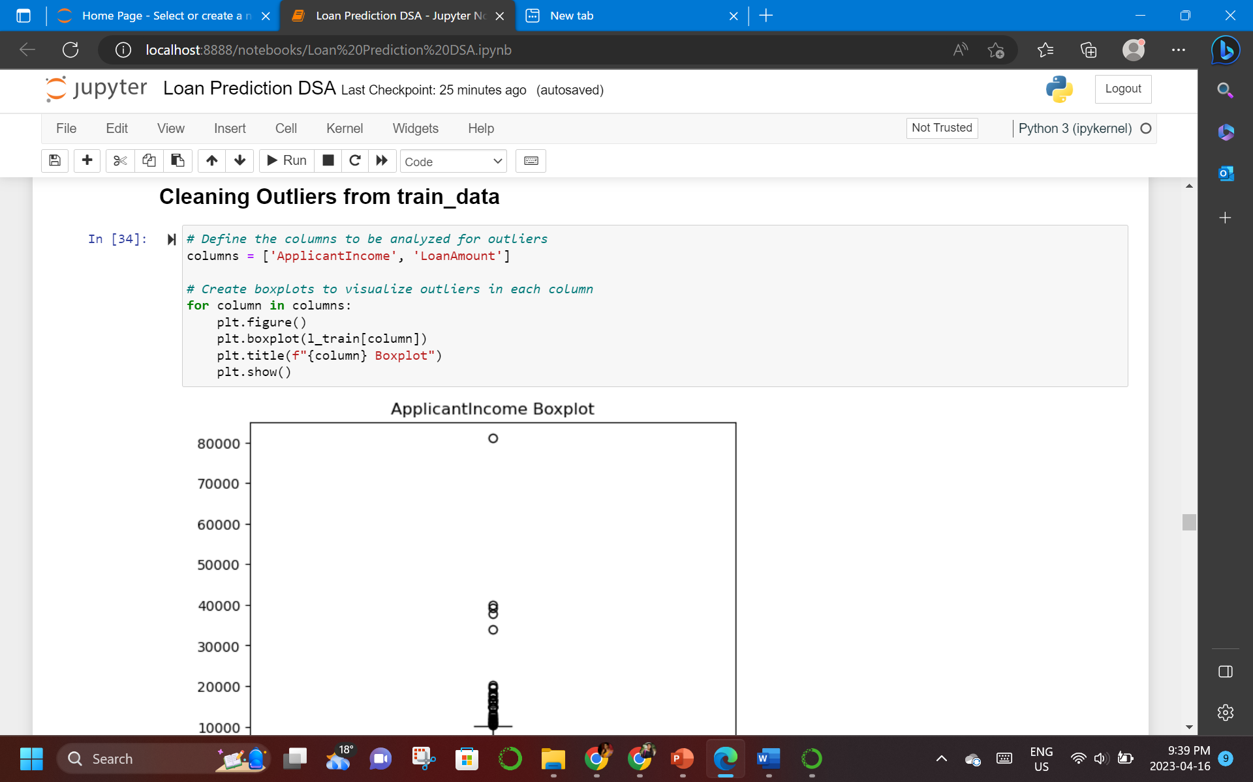
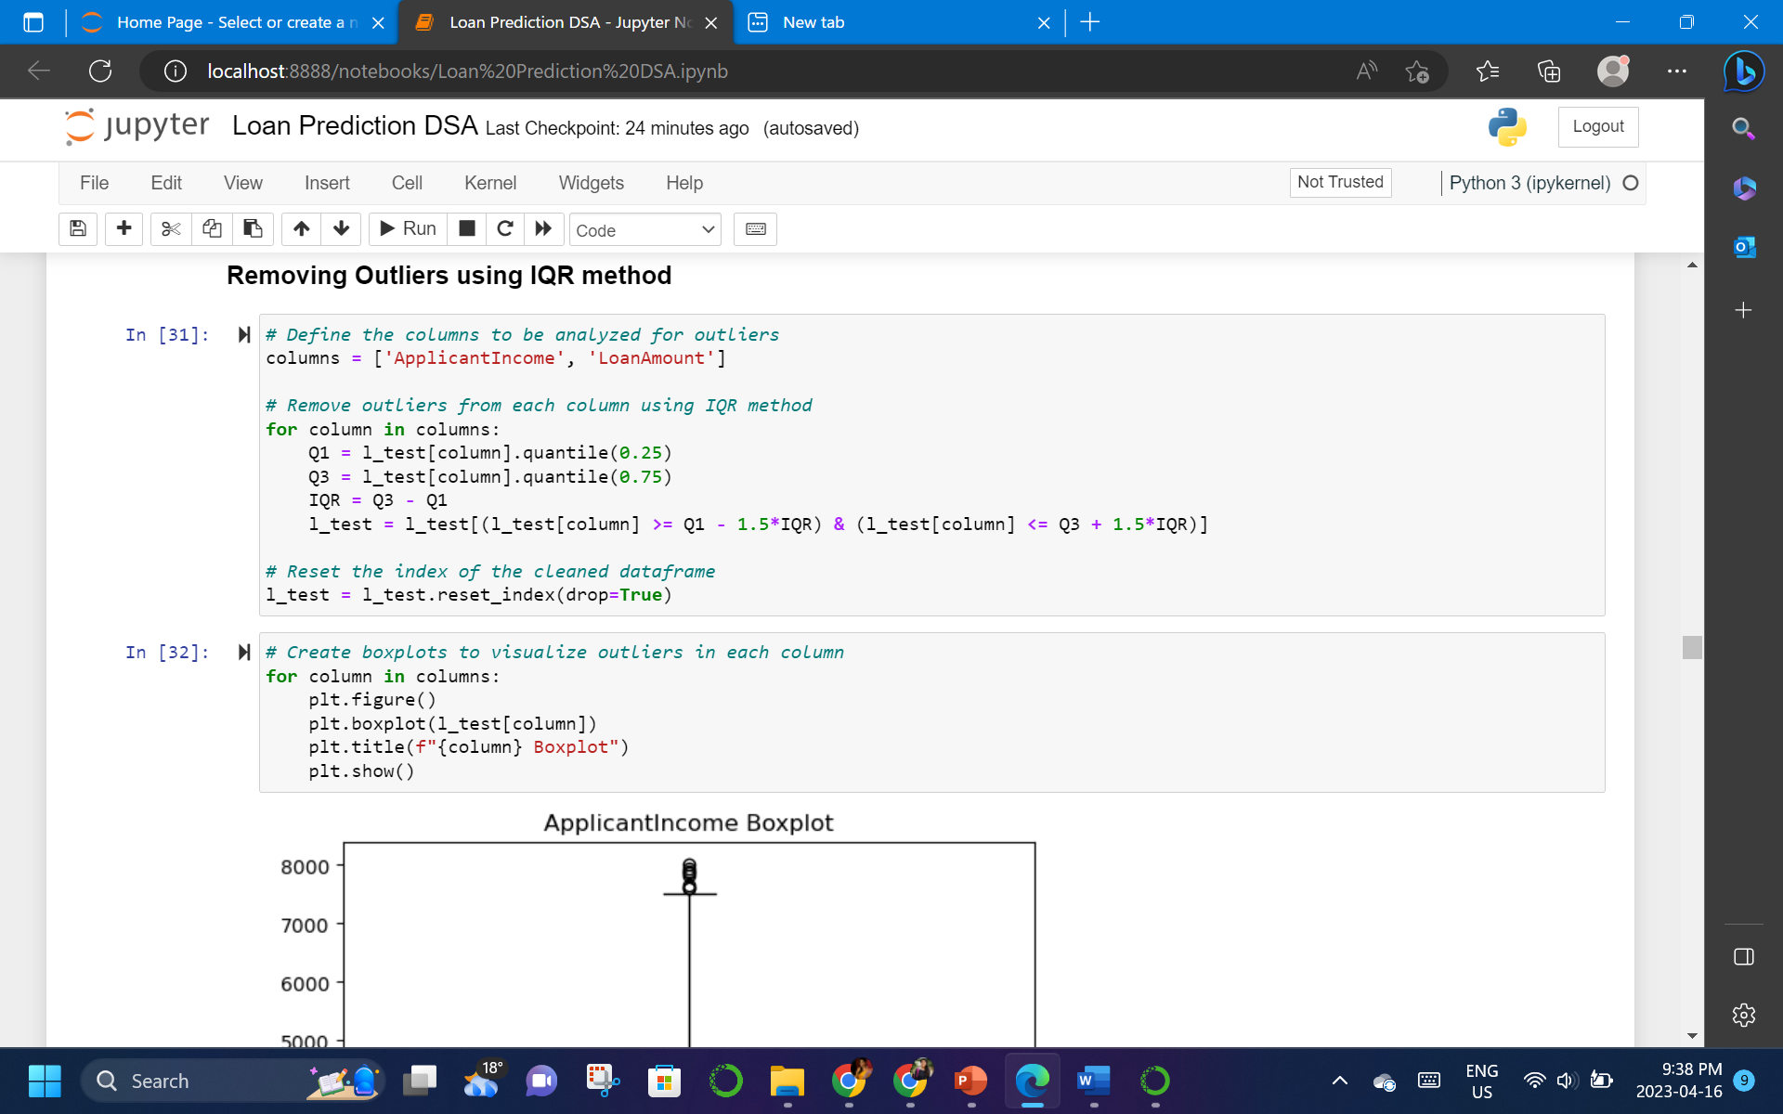
STEP 7 TO 9

Slide 11
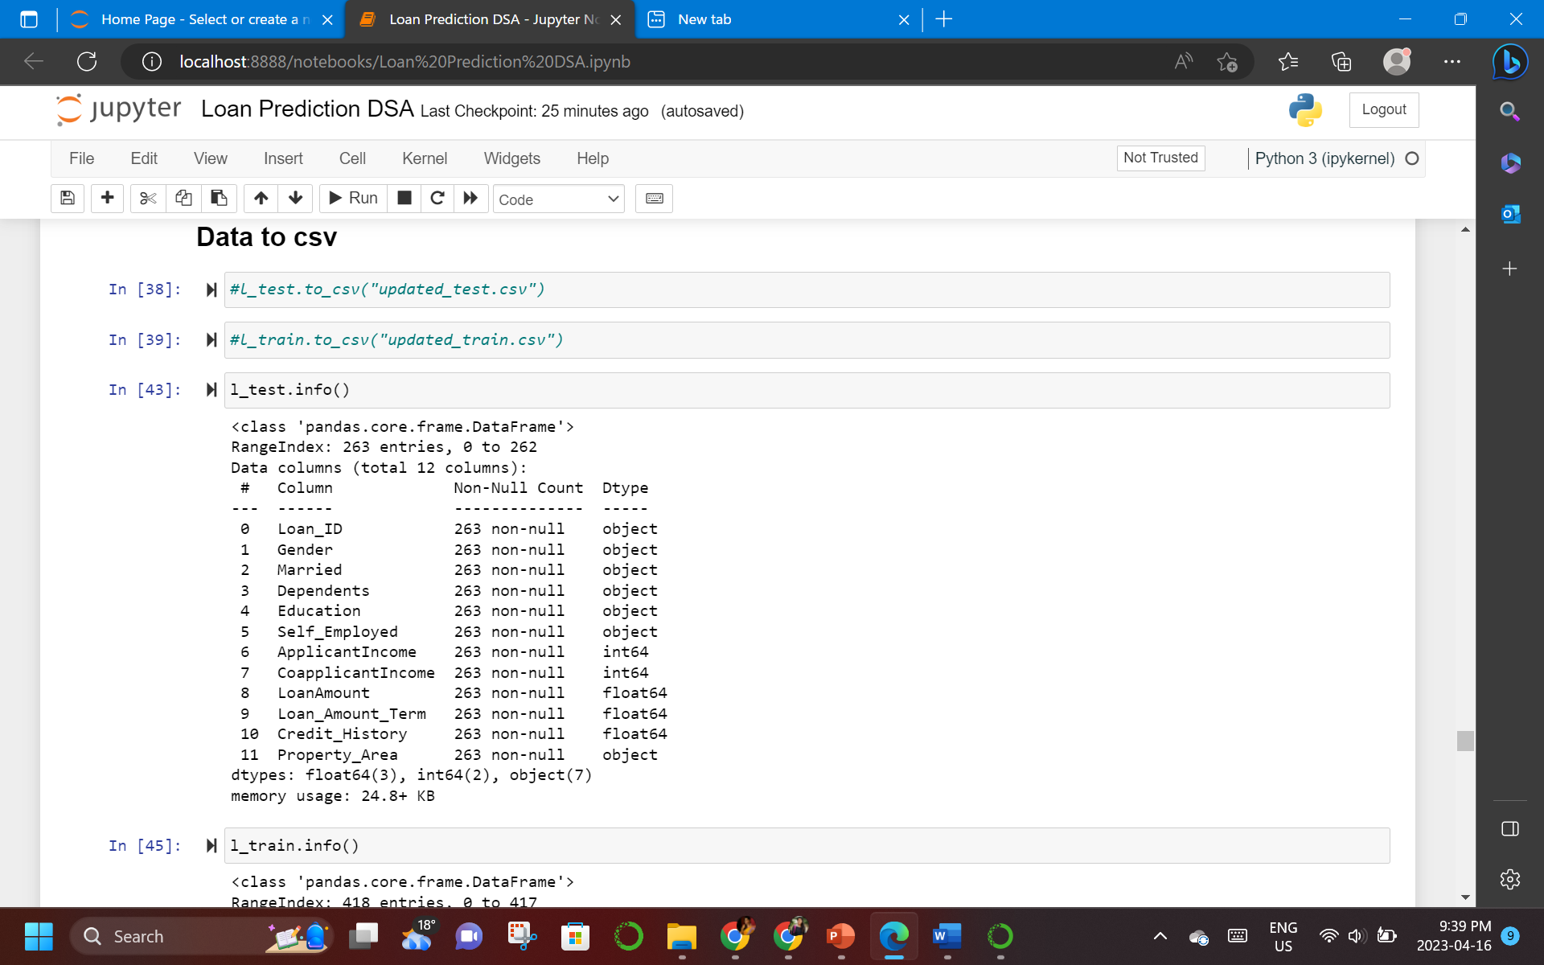
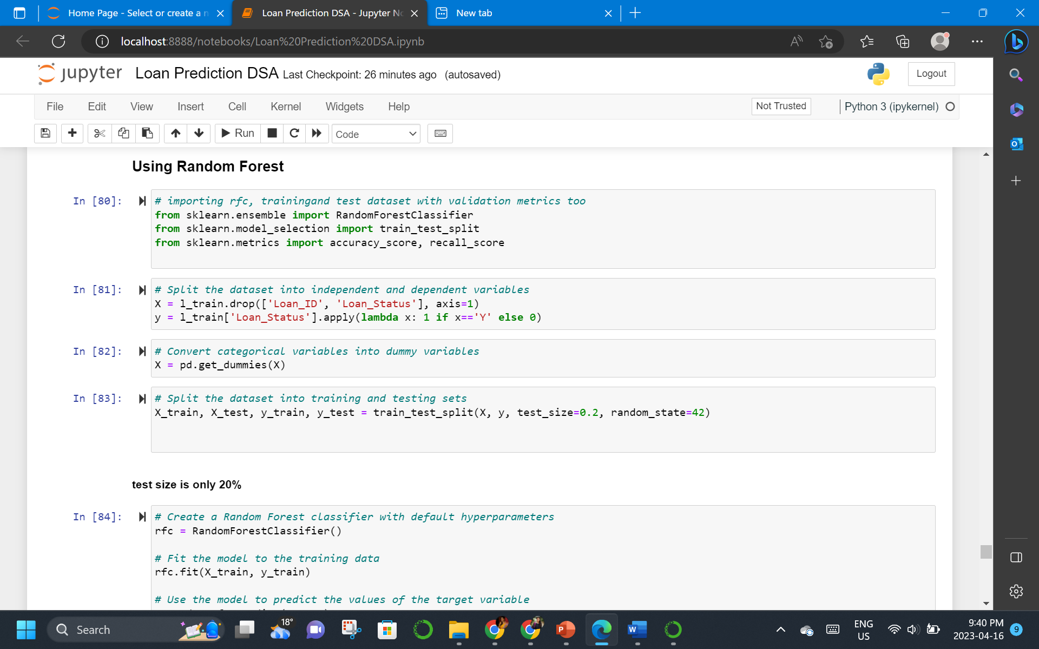
STEP 10 TO 12

Slide 12

MODELLING
Random forest algorithm was used with a test size of only 20%.
The efficiency of the model was 74%, while accuracy and recall were also 74% and 89%, respectively.
Both training and test datasets were the same.
Other classification techniques such as logistic regression and decision trees were employed.
GridSearchCV's adjustments were made to hyperparameters.
Evaluation metrics such as F1 score, recall, accuracy, and precision were used.
Random forest had the highest F1 score, accuracy, and precision.
Confusion matrix showed 30 true positives and 54 true negatives with an error rate of 0.0.

Slide 13
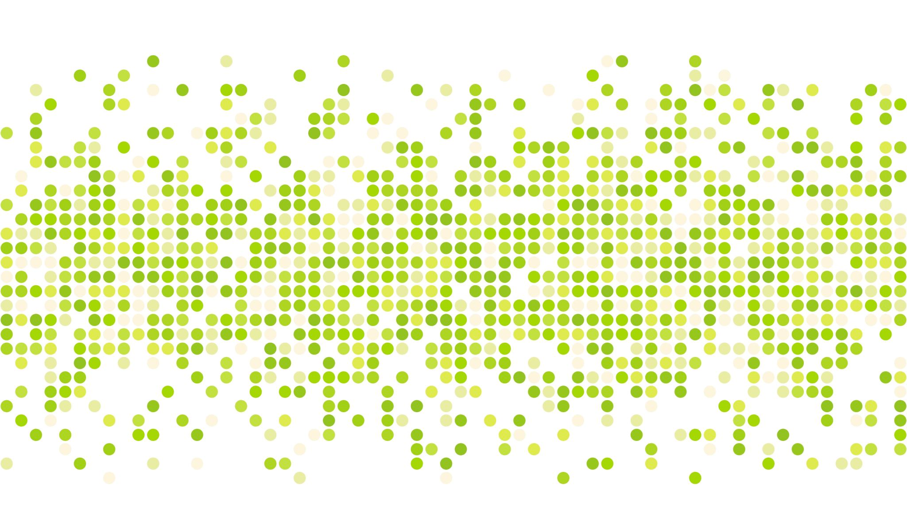
PREDICTION

Slide 14
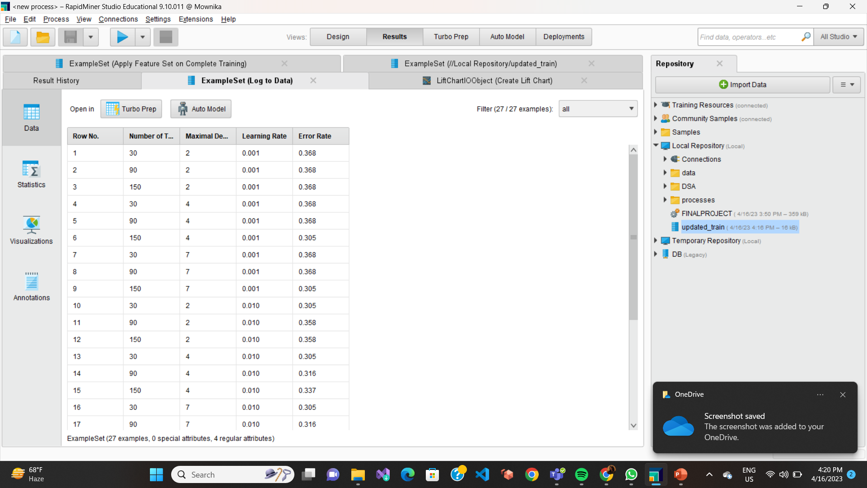
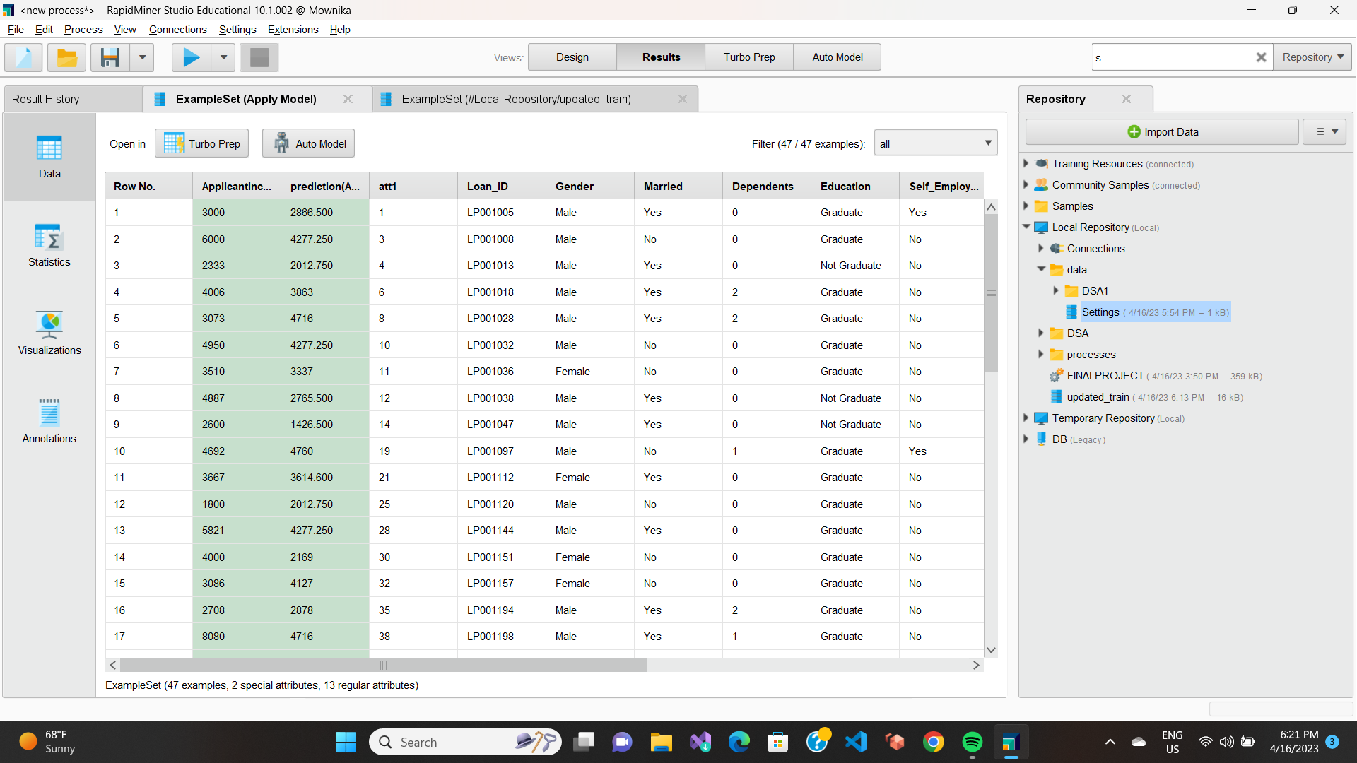
RAPID MINER
DATA RESULTS – LOG DATA
DATA RESULTS – APPLY MODEL

Slide 15
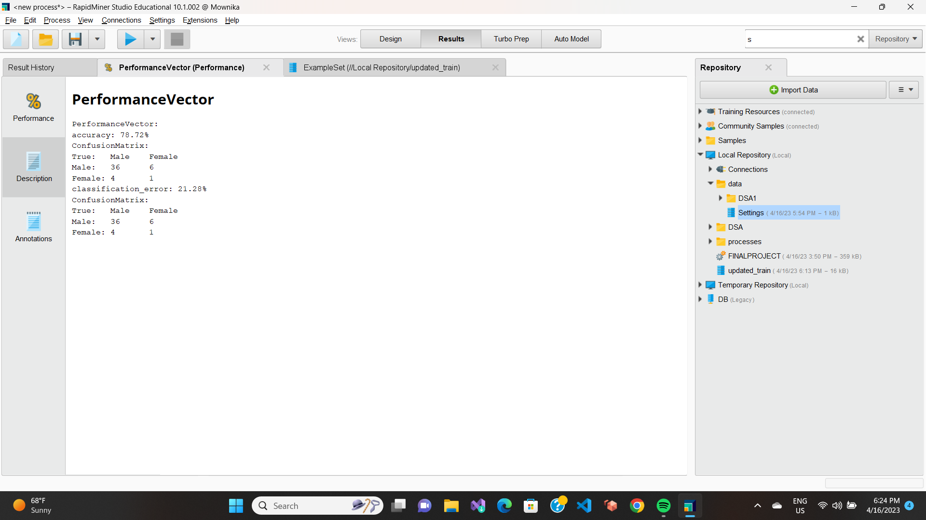
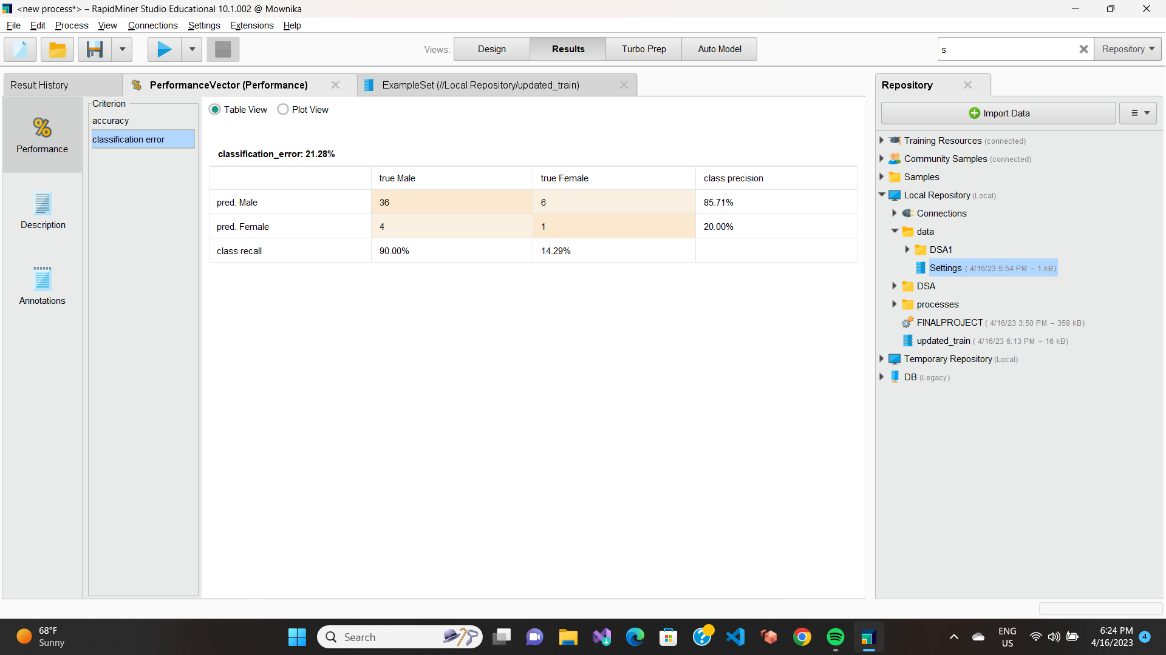
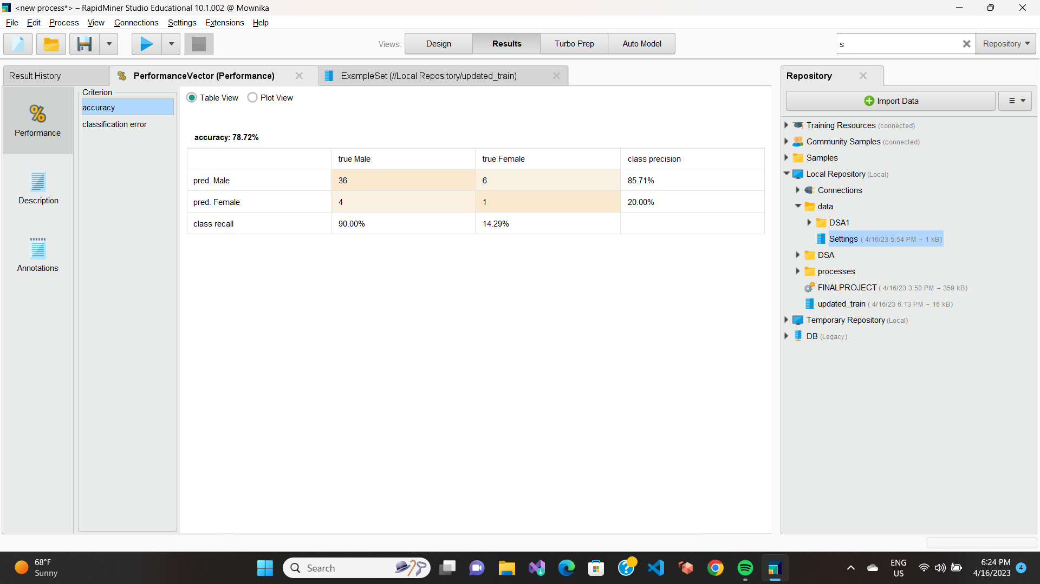
RAPID MINER
CLASSIFICATION ERROR
PERFORMANCE VECTOR
ACCURACY

Slide 16
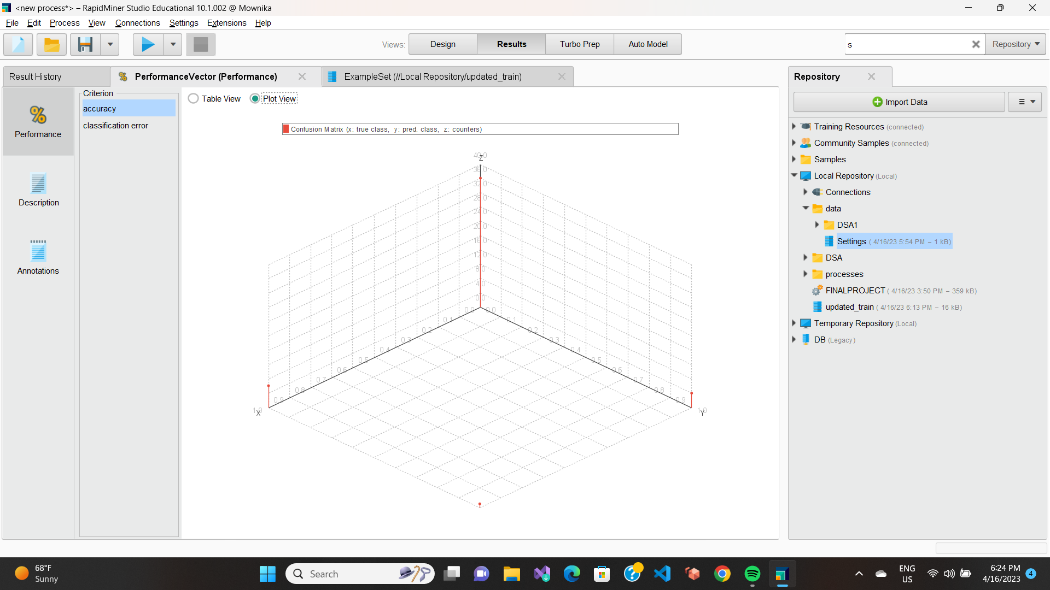
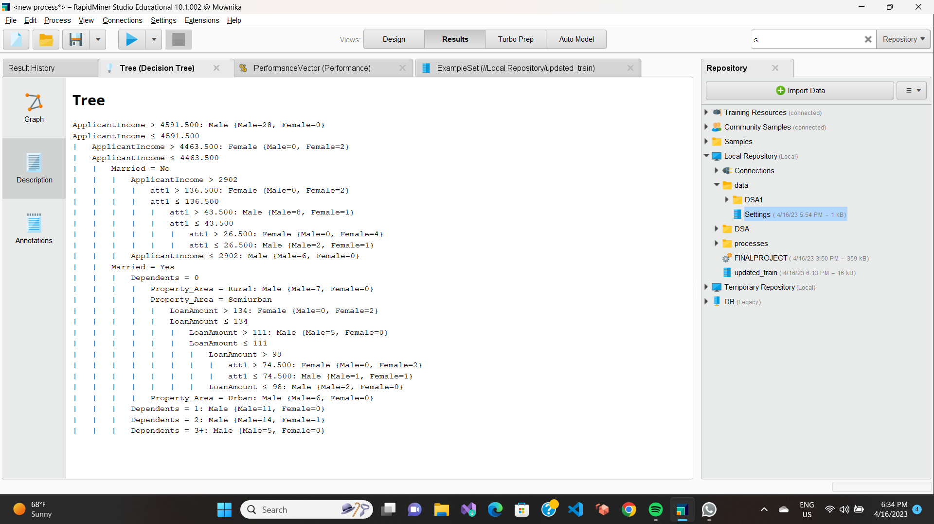
RAPID MINER
PLOT VIEW OF
PERFORMANCE ACCURACY
TREE DESCRIPTION

Slide 17
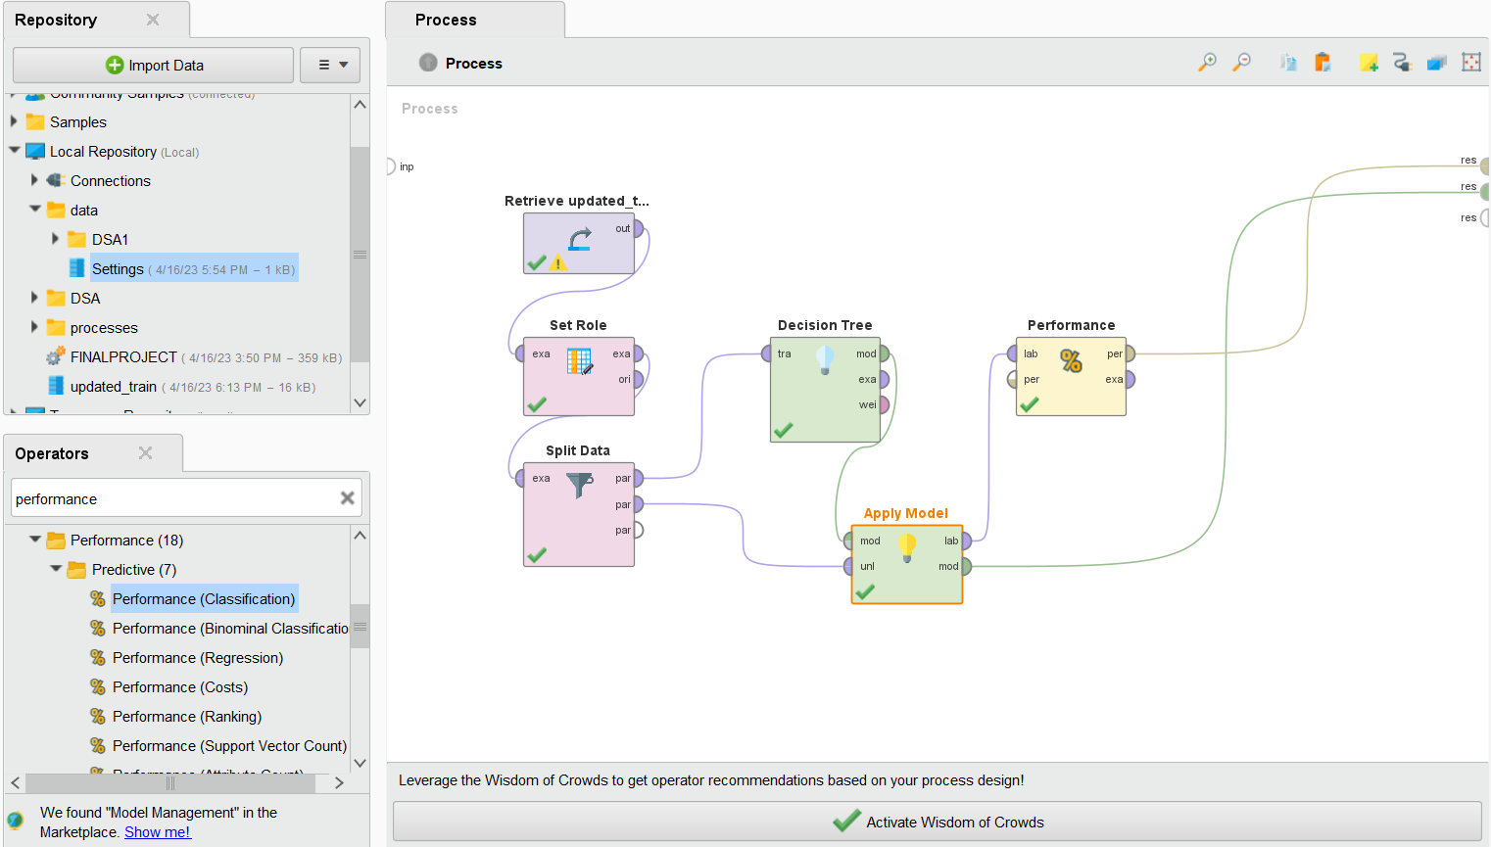
RAPID MINER
PROCESS MODEL

Slide 18

VISUALIZATION

Slide 19

EXPLORATORY DATA ANALYSIS
The data set contains information about customers, including their demographics and transaction history.
The data set is relatively large, with several variables that need to be explored.
The variables include both categorical and numerical data, which require different types of analysis.
The first step in EDA is to examine the distribution of the variables and identify any outliers or missing values.
Histograms, box plots, and scatterplots are useful tools for visualizing the data and identifying patterns.
Correlation analysis can be used to identify relationships between variables.
Grouping the data by different variables, such as age or gender, can reveal insights into customer behavior.
EDA can be used to identify variables that are most strongly correlated with the outcome variable and can be used for feature selection in machine learning models.

Slide 20
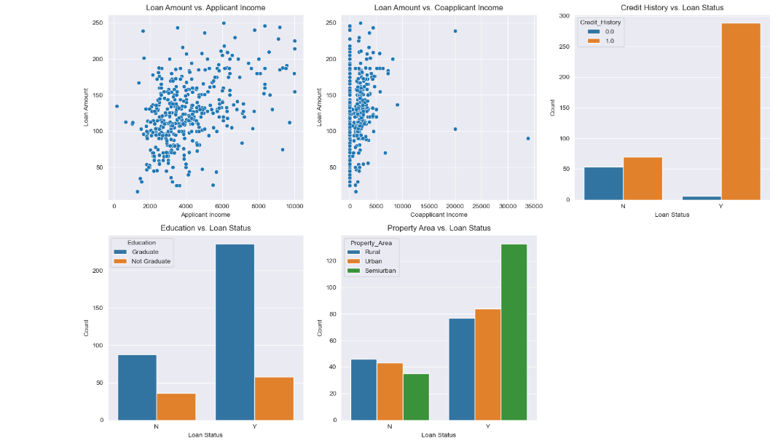
RELATIONSHIP CHARTS

Slide 21
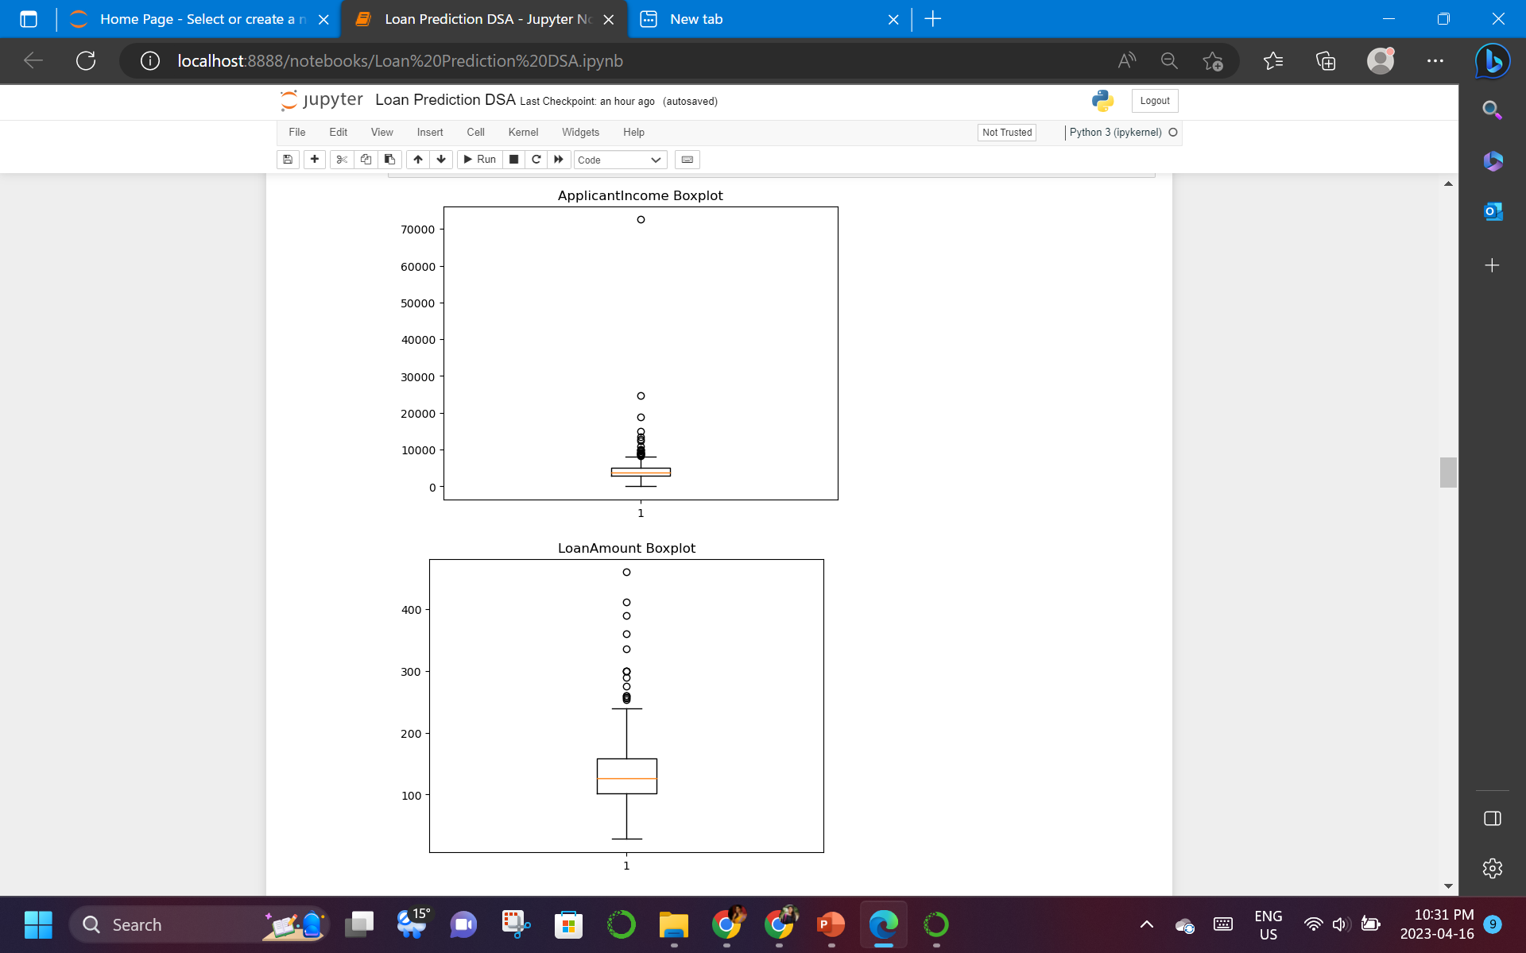
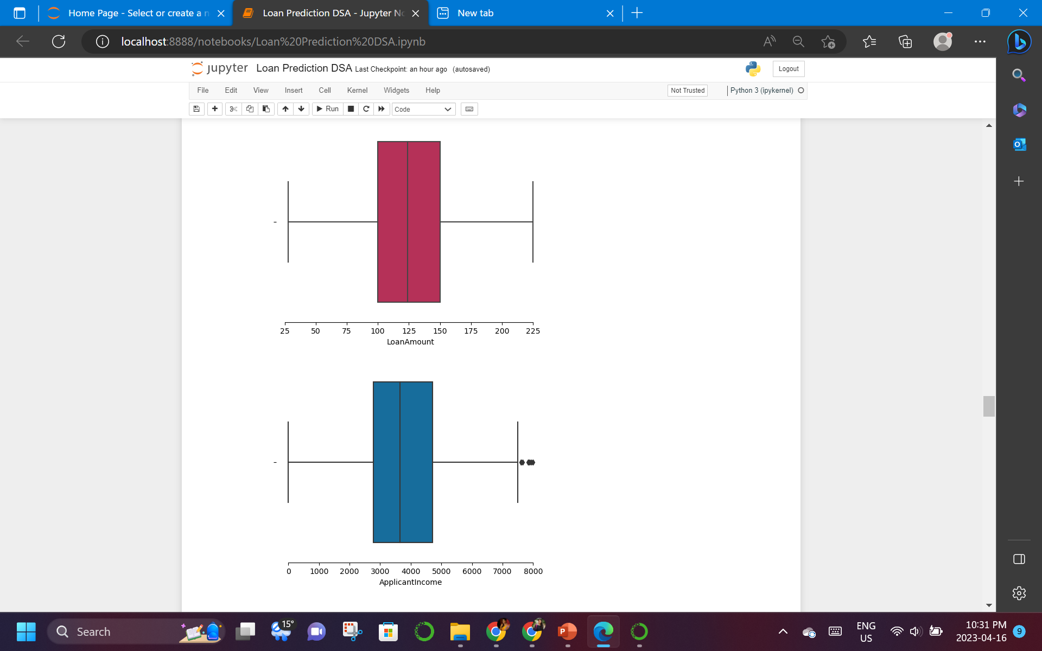
BOXPLOT
BEFORE CLEANING
AFTER CLEANING

Slide 22

CONCLUSION
The Loan data initially had 614 rows, but after cleaning, removing duplicates, null values, characters, and outliers, it reduced to around 367.
The accuracy of the model was 74%, with an error percentage of around 26%, indicating a probability of 1/4th error.
The True Positive rate or Recall rate was only 89%.
The main limitation of the data was its illogical nature in giving loans to individuals, with loans given to everyone regardless of their income.
Although the random forest model showed good performance, further exploration of other models and feature engineering techniques could potentially improve the accuracy and precision of the model.
• Additionally, it is important to note that the data used in this project was limited in scope and may not be representative of larger datasets or different populations. Further research and data collection may be necessary to improve the generalizability of the model.

Slide 23

THANK YOU

